Slide 1
Embedded System Course
Lecture 9: Peripheral I2C

Slide 2
Guideline for training material development in Powerpoint format (please delete this slide after completing the material)
<Considering to the lesson duration, it is recommended to design the slides where each of them takes in average about 3 minutes to present. Time for exercise and case-study is estimated and allocated separately>
<The author may use the Notes part to provide more detail information for instructor. Slides and Notes are to be printed and given to trainer as Instructor manual>

Slide 3

Lesson Objectives
Understanding basis concepts about I2C and how to transmit/receive data via I2C bus
Understanding on how to configure the KL46 I2C module.

Slide 4
Table of contents
Introduction to I2C
Freedom KL46 I2C

Slide 5
Requirements and Problems
Section 1: Introduction to I2C

Slide 6
Requirements and Problems
Customer requirements:
Serial and synchronous
2 wires
Large number of devices
Multi-masters, multi-slaves
2 devices communicate at a time
Switching device role runtime
Handshake and Plug-play
Notes:
Assume that we are members of NXP semiconductor solution team, we received customer requirements about a “new” communication protocol with following functionalities:
It is serial and synchronous communication
It has minimum number of wire connection (2 wires like UART)
It can support large number of nodes on a PCB (MCU, sensor, external memory: flash, eeprom…)
It has multiple-masters and multiple-slaves
It supports switching device role of nodes in run-time: master to slave or slave to master
It has handshake mechanism
We don’t have requirements about speed and range of connection wire: can be low speed and short-range wires

Slide 7
Requirements and Problems
UART | SPI
Asynchronous serial | Synchronous serial
2 wires | >4 wires
2 devices | Multiple-devices
- | One master, multi-slave
- | Not support switch role runtime
Addition wires for handshake | Addition wires for handshake
Notes:
We had 2 existing communication protocols: UART and SPI. Compare with the requirements

Slide 8

Problem #1
Synchronous serial
Two-wires
1 wire for synchronous clock
1 wire for data
Large number of devices
Multi-masters, multi-slaves
Switching device role runtime
2 wires are both Input and Output
Notes:
Slave receives clock and command from master, master sends clock, command and receives response from slave
Master switches role to slave -> it has to receive clock from another master.

Slide 9
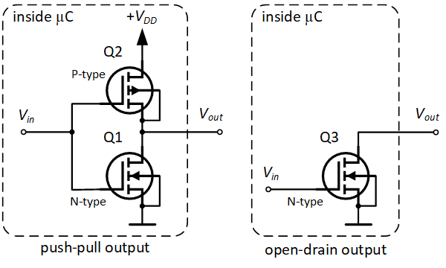
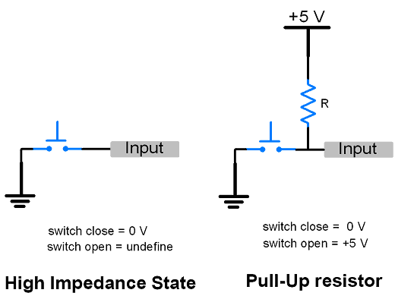
Problem #1
GPIO modes:
Output:
  Push-pull
  Open-drain
Input:
  Analog
  Floating
  Pull down
  Pull up
Notes:
To support a pin is both input and output, which mode of GPIO should be chosen?

Slide 10
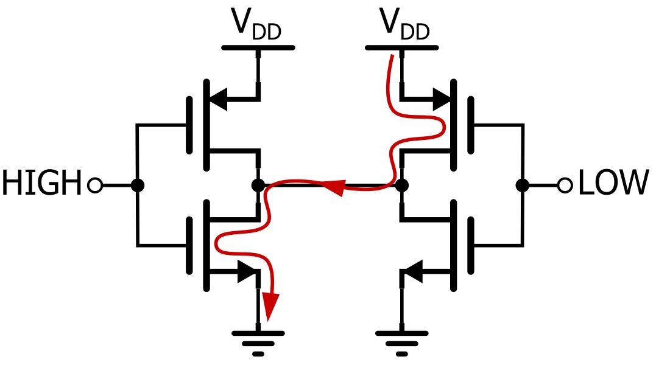
Solution #1
Push-pull
Notes:
Image that we have 2 masters, and both of them want to send command at the same time, one sends “1” and one sends “0”
With push-pull mode, Vdd -> MOSFET (or resistor with small resistance) -> bus -> MOSFET (same) -> Ground => Cause of short circuit => damage.

Slide 11
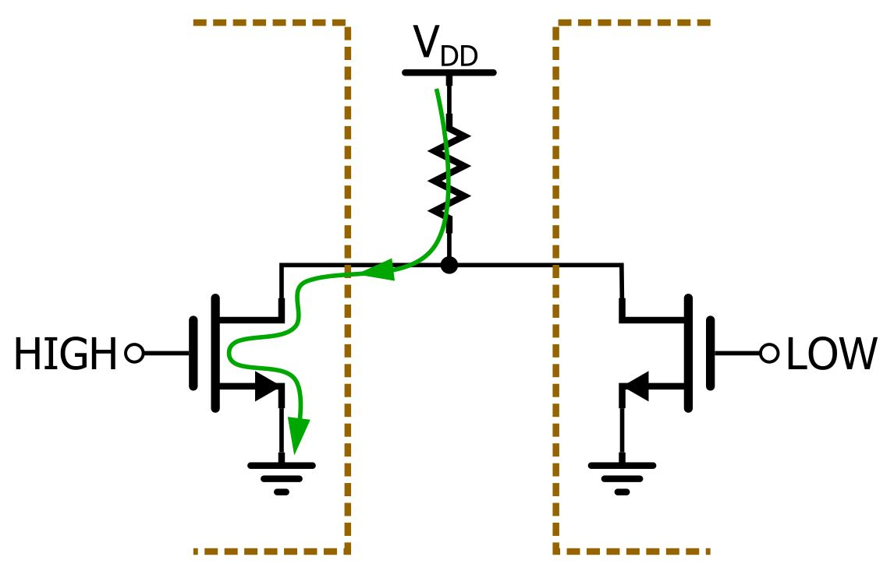
Solution #1
Open drain
Notes:
Image that we have 2 masters, and both of them want to send command at the same time, one sends “1” and one sends “0”
With open-drain mode, Vdd -> external resister (high resistance) -> bus -> MOSFET (unlock) -> Ground => OK.

Slide 12
Solution #1
Which master is ignored on the bus?
Notes:
Image that we have 2 masters, and both of them want to send command at the same time, one sends “1” and one sends “0”
With open-drain mode, Vdd -> external resister (high resistance) -> bus -> MOSFET (unlock) -> Ground => OK.
Which master is ignored on the bus? Answer: the master sends “1” (lock the MOSFET). It is called AND-wire.

Slide 13
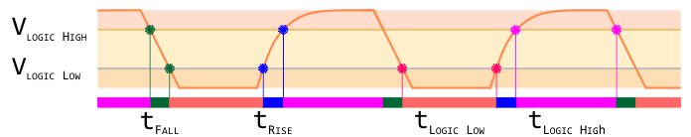
Problem #2
Semiconductor devices always contain capacitance
t ~ RC
Pull-up resister with high resistance value will decrease frequency of this communication protocol.
But lower resistance value will be cause of higher current (I) in circuit.
Notes:
In RC circuit, rise time and fall time depend on value of R and C. With larger value of RC, rise and fall time are increased.
If frequency increases, time of duty cycle decreases, voltage can not reach the logic high or low -> unknown state of communication.
https://www.allaboutcircuits.com/technical-articles/i2c-design-mathematics-capacitance-and-resistance/

Slide 14

Solution #2
Provide devices, PCB with lower capacitance value
Decrease number of devices in circuit to decrease capacitance of circuit
Customers have to calculate value of the pull-up resisters.
Notes:
Customers hate this :D. but provider can describe maximum value of resistor

Slide 15

Problem #3
How do master select one slave to communicate at a time?
How do master and slave handshake,
plug-play?
Notes:
a handshake is an automated process of negotiation between two participants through the exchange of information that establishes the protocols of a communication link at the start of the communication, before full communication begins

Slide 16
Solution #3
Provide each device in this bus a unique address
Handshaking and Plug-play:
  1 bit ACK/ NACK after each byte
  Slave controls the clock

Slide 17


Slide 18
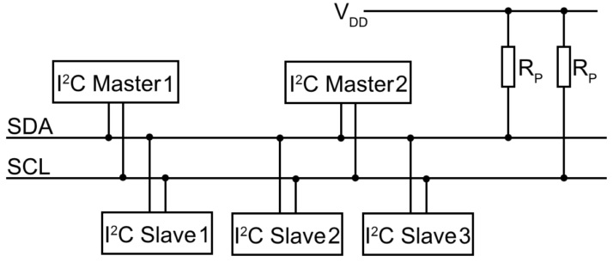
Inter integrated circuit introduction
Notes:
With all characteristics mentioned in previous slides, we have I2C stands for inter integrated circuit
• I2C bus = Inter-IC bus
• Bus developed by Philips in the 80’s

Slide 19
Inter integrated circuit introduction
Speed:
  Standard mode: up to 100 kbit/s
  Fast mode: up to 400 kbit/s
  Fast mode plus: up to 1Mbit/s
  High-speed mode: up to 3.4Mbit/s
  Ultra-fast mode: up to 5Mbit/s (unidirectional bus)
Max capacitance load: 400pF
Address length: 7 or 10 bit
Voltage level: various, typical voltages used are 1.8V, 3.3V, 5V
Notes:
With all characteristics mentioned in previous slides, we have I2C stands for inter integrated circuit
• I2C bus = Inter-IC bus
• Bus developed by Philips in the 80’s

Slide 20
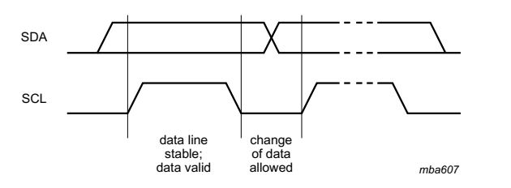
Data
Notes:
The data on the SDA line must be stable during the HIGH period of the clock. The HIGH or LOW state of the data line can only change when the clock signal on the SCL line is LOW. One clock pulse is generated for each data bit transferred.

Slide 21
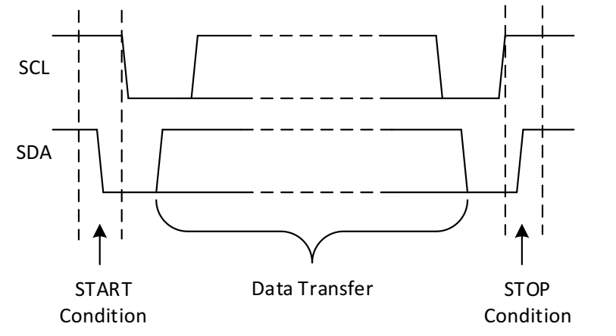
Start and Stop
Notes:
All transactions begin with a START (S) and are terminated by a STOP (P). A HIGH to LOW transition on the SDA line while SCL is HIGH defines a START condition.
A LOW to HIGH transition on the SDA line while SCL is HIGH defines a STOP condition. START and STOP conditions are always generated by the master. The bus is considered
to be busy after the START condition. The bus is considered to be free again a certain time after the STOP condition. This bus free situation is specified in Section 6.
The bus stays busy if a repeated START (Sr) is generated instead of a STOP condition. In this respect, the START (S) and repeated START (Sr) conditions are functionally identical.
For the remainder of this document, therefore, the S symbol is used as a generic term to represent both the START and repeated START conditions, unless Sr is particularly
relevant.

Slide 22
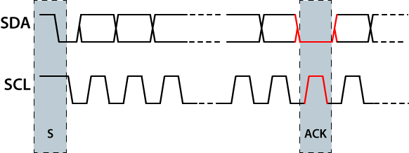
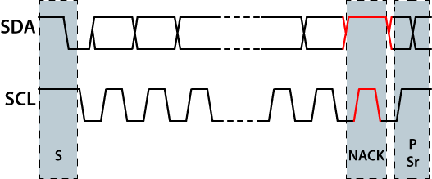
ACK and NACK
Notes:
The Acknowledge signal is defined as follows: the transmitter releases the SDA line during the acknowledge clock pulse so the receiver can pull the SDA line LOW and it
remains stable LOW during the HIGH period of this clock pulse.
There are five conditions that lead to the generation of a NACK:
1. No receiver is present on the bus with the transmitted address so there is no device to
respond with an acknowledge.
2. The receiver is unable to receive or transmit because it is performing some real-time
function and is not ready to start communication with the master.
3. During the transfer, the receiver gets data or commands that it does not understand.
4. During the transfer, the receiver cannot receive any more data bytes.
5. A master-receiver must signal the end of the transfer to the slave transmitter.

Slide 23
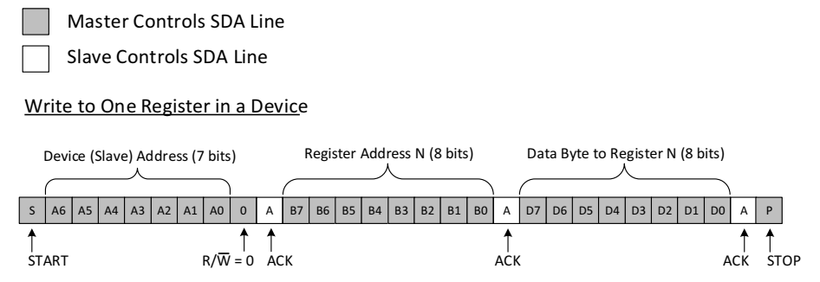
Data transmission

Slide 24
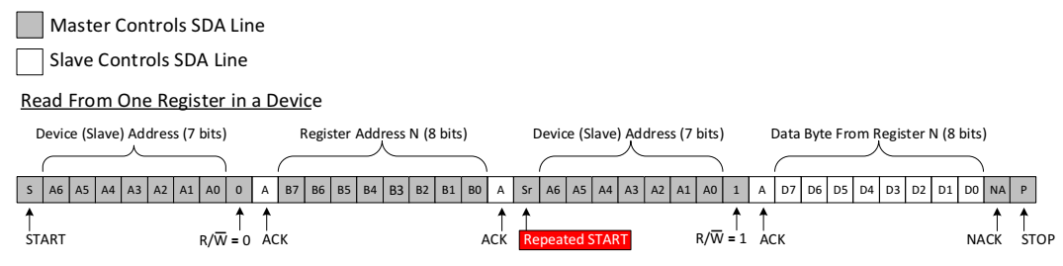
Data reception

Slide 25
I2C procedure
Wait the bus is free
Send START
Provide CLOCK
Send ADDRESS, R/W bit
Receive ACK/NACK
Send or receive DATA
Receive ACK/NACK after each 8bit
Send STOP
Notes:
1. Bus is free when SCL and SDA are both high.
2. All other ICs then LISTEN to the bus data to see whether they might be the one who will be called up (addressed).

Slide 26


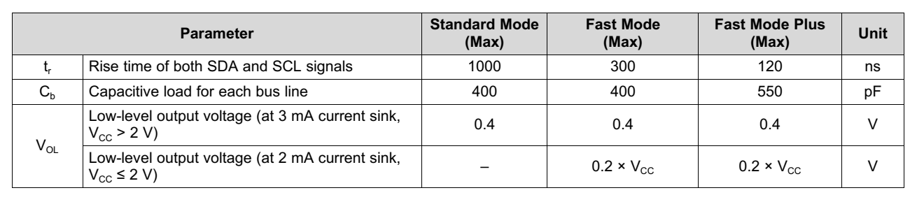
Pull-up resistor
Notes:
I2C Bus Pullup Resistor Calculation
Application Report
SLVA689–February 2015
Texas Intrusments

Slide 27
Section 1: Summary
I2C characteristics
Data transmission and reception

Slide 28

Section #1: Q&A

Slide 29
Freedom KL46 I2C introduction
Section 2: Freedom KL46 I2C

Slide 30
KL46 I2C main features
I2C bus specification support
Software-selectable acknowledge bit
Interrupt-driven byte-by-byte data transfer
Arbitration-lost interrupt with automatic mode switching from master to slave
Calling address identification interrupt
Bus busy detection
General call recognition
DMA support
Support for System Management Bus (SMBus) Specification, version 2
Notes:
General call is:
Master send address with all bit is 0, all slaves that pre-configured to accept general call will receive this command
Commands are defined, e.g. reset devices.

Slide 31
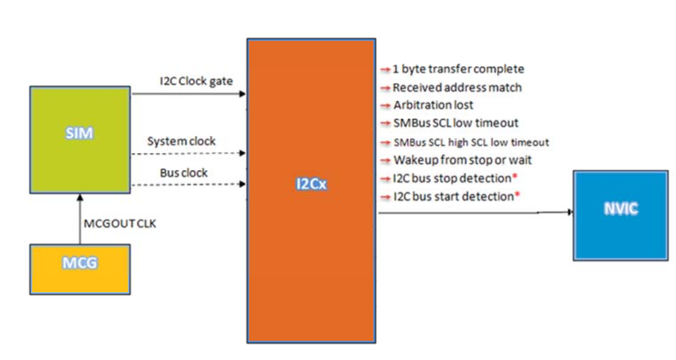
I2C interconnections

Slide 32
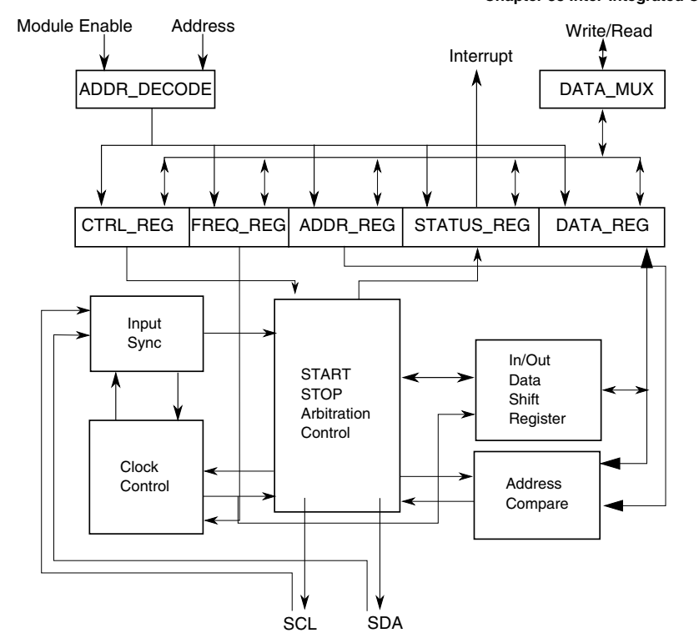
I2C functional block diagram

Slide 33
Initialization
Slave:
1. Write: Control Register 2
  to enable or disable general call
  to select 10-bit or 7-bit addressing mode
Write: Address Register 1 to set the slave address
Write: Control Register 1 to enable the I2C module and interrupts
Initialize RAM variables (IICEN = 1 and IICIE = 1) for transmit data
Interrupt routine

Slide 34
Initialization
Master:
Write: Frequency Divider register to set the I2C baud rate
Write: Control Register 1 to enable the I2C module and interrupts
Initialize RAM variables (IICEN = 1 and IICIE = 1) for transmit data
Initialize RAM variables used to achieve the routine shown in the following figure
Write: Control Register 1 to enable TX
Write: Control Register 1 to enable MST (master mode)
Write: Data register with the address of the target slave

Slide 35
Further study
I2C Ultra-fast mode
I3C
SMBus
PMBus
IPMI
ATCA
DDC

Slide 36
References
NXP - UM10204 - I2C-bus specification and user manual - Rev. 6 - 4 April 2014
TI - SLVA704 - Understanding the I2C Bus - June 2015
Philips Semiconductors - AN10216-01 - I2C Manual – March 24, 2003
TI – SLVA689 - I2C Bus Pullup Resistor Calculation – Feb 2015
NXP - KL46 Sub-Family Reference Manual - Rev. 3, July 2013
NXP – I2C for Kinetis MCUs

Slide 37
Lesson Summary
Introduction to I2C
  Open-drain pin
  Pull-up resistor
  Arbitration
  Handshake, Plug-play
  …
Freedom KL46 I2C
  Block diagram
  Initialization
  …

Slide 38
Q&A

Slide 39

Thank you

